Slide 1
AMI Simulation Flow Round 3
Fangyi Rao

Slide 2
Motivations
Handle Init-only Rx properly in both time domain and statistical flows for normal and redriver channels
Provide full redriver channel impulse to Rx Init for optimization
Eliminate the need for deconvolution

Slide 3
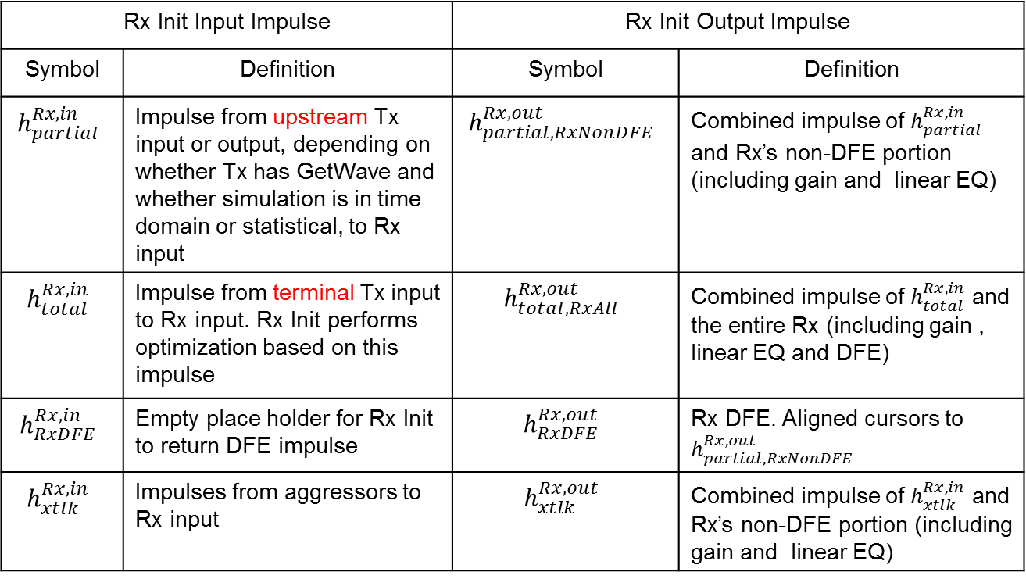
Summary
No change to Tx Init
Augment Rx Init impulse matrix by two columns for total impulse and Rx DFE
Rx Init Input Impulse |  | Rx Init Output Impulse
Symbol | Definition | Symbol | Definition
$$h_{partial}^{Rx,in}$$ | Impulse from upstream Tx input or output, depending on whether Tx has GetWave and whether simulation is in time domain or statistical, to Rx input | $$h_{partial,RxNonDFE}^{Rx,out}$$ | Combined impulse of $h_{partial}^{Rx,in}$ and Rx’s non-DFE portion (including gain and linear EQ)
$$h_{total}^{Rx,in}$$ | Impulse from terminal Tx input to Rx input. Rx Init performs optimization based on this impulse | $$h_{total,RxAll}^{Rx,out}$$ | Combined impulse of $h_{total}^{Rx,in}$ and the entire Rx (including gain , linear EQ and DFE)
$$h_{RxDFE}^{Rx,in}$$ | Empty place holder for Rx Init to return DFE impulse | $$h_{RxDFE}^{Rx,out}$$ | Rx DFE. Aligned cursors to $h_{partial,RxNonDFE}^{Rx,out}$
$$h_{xtlk}^{Rx,in}$$ | Impulses from aggressors to Rx input | $$h_{xtlk}^{Rx,out}$$ | Combined impulse of $h_{xtlk}^{Rx,in}$ and Rx’s non-DFE portion (including gain and linear EQ)

Slide 4
Convention
Normal flow: channel doesn’t have repeater
Redriver flow: channel has redrivers
on left
on right
input partial impulse to Rx Init
output partial impulse of Rx Init
on right
output Rx DFE impulse of Rx Init
on left
on right
input total impulse to Rx Init
output total impulse of Rx Init

Slide 5

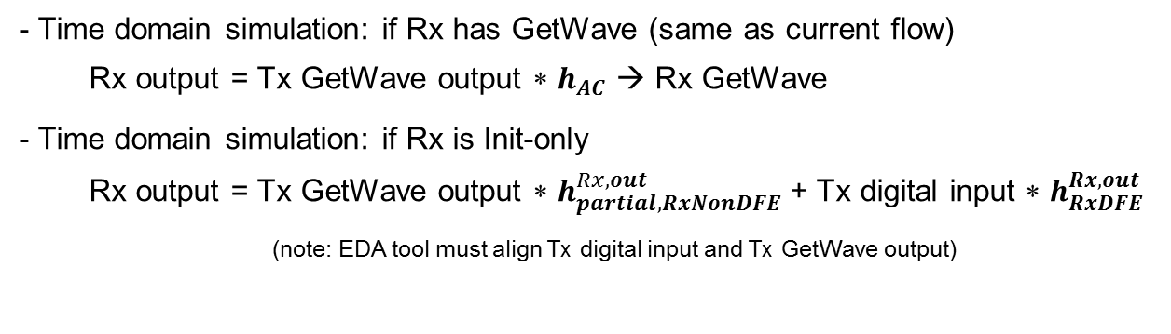




Normal Time Domain Flow: if Tx has GetWave
$$h_{partial}^{Rx,in}=h_{AC}$$
$h_{partial,RxNonDFE}^{Rx,out}$ = $h_{partial}^{Rx,in}{ ∗h}_{RxNonDFE}$
Tx
AC
Rx
Tx
AC
Rx Non-DFE
align
cursor
Rx Init input
impulses
Rx Init output
impulses
$$h_{RxDFE}^{Rx,out}$$
Rx DFE
$$h_{total}^{Rx,in}=Tx Init output$$
$$h_{total,RxAll}^{Rx,out}$$
(same as current output impulse)
(same as current input impulse)
Rx Non-DFE
Tx
AC
Rx
Tx
AC
Rx DFE
- Time domain simulation: if Rx has GetWave (same as current flow)
Rx output = Tx GetWave output ∗ $h_{AC}$ → Rx GetWave
- Time domain simulation: if Rx is Init-only
Rx output = Tx GetWave output ∗ $h_{partial,RxNonDFE}^{Rx,out}$+ Tx digital input ∗ $h_{RxDFE}^{Rx,out}$
(note: EDA tool must align Tx digital input and Tx GetWave output)

Slide 6
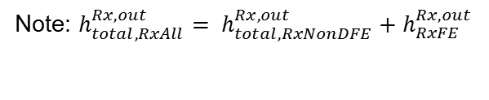

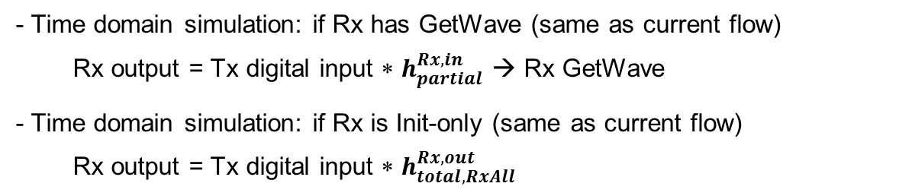




Normal Time Domain Flow: if Tx is Init-only
$$h_{partial}^{Rx,in}=Tx Init output$$
$h_{partial,RxNonDFE}^{Rx,out}$ = $h_{partial}^{Rx,in}{ ∗h}_{RxNonDFE}$
Tx
AC
Rx
Tx
AC
Rx Non-DFE
align
cursor
Rx Init input
impulses
Rx Init output
impulses
Rx DFE
$$h_{RxDFE}^{Rx,out}$$
$$h_{total}^{Rx,in}=Tx Init output$$
$$h_{total,RxAll}^{Rx,out}$$
(same as current output impulse)
(same as current input impulse)
Rx Non-DFE
Tx
AC
Rx
Tx
AC
Rx DFE
- Time domain simulation: if Rx has GetWave (same as current flow)
Rx output = Tx digital input ∗ $h_{partial}^{Rx,in}$ → Rx GetWave
- Time domain simulation: if Rx is Init-only (same as current flow)
Rx output = Tx digital input ∗ $h_{total,RxAll}^{Rx,out}$
Note: $h_{total,RxAll}^{Rx,out}= h_{total,RxNonDFE}^{Rx,out}+h_{RxFE}^{Rx,out}$

Slide 7
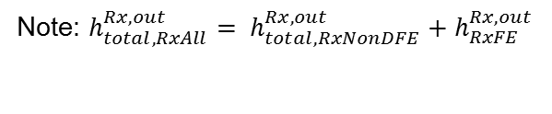

Normal Statistical Flow
$$h_{partial}^{Rx,in}=Tx Init output$$
$h_{partial,RxNonDFE}^{Rx,out}$ = $h_{partial}^{Rx,in}$ $∗{ h}_{RxNonDFE}$
Tx
AC
Rx
Tx
AC
Rx Non-DFE
align
cursor
Rx Init input
impulses
Rx Init output
impulses
Rx DFE
$$h_{RxDFE}^{Rx,out}$$
$$h_{total}^{Rx,in}=Tx Init output$$
$$h_{total,RxAll}^{Rx,out}$$
(same as current output impulse)
(same as current input impulse)
Rx Non-DFE
Tx
AC
Rx
Tx
AC
Rx DFE
- Statistical uses $h_{total,RxAll}^{Rx,out}$ (same as current flow)
Note: $h_{total,RxAll}^{Rx,out}= h_{total,RxNonDFE}^{Rx,out}+h_{RxFE}^{Rx,out}$

Slide 8
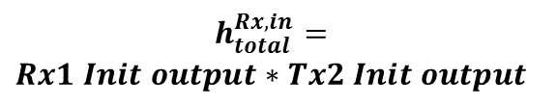
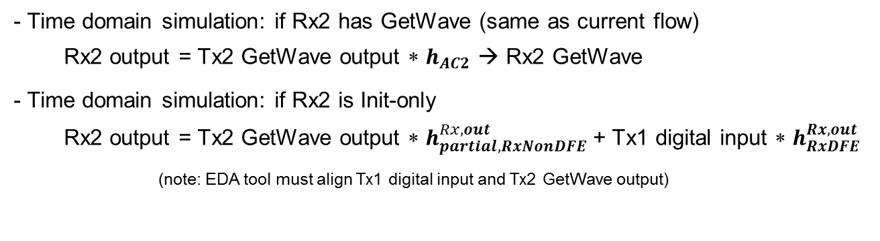



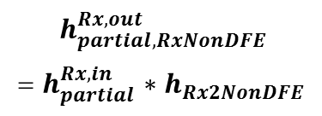
Redriver Time Domain Flow: if Tx2 has GetWave
$$h_{partial,RxNonDFE}^{Rx,out}$$
= $h_{partial}^{Rx,in}$ $∗h_{Rx2NonDFE}$
$$h_{partial}^{Rx,in}=h_{AC2}$$
Tx1
AC1
Rx1
Tx2
AC2
Rx2
Tx1
AC1
Rx1
Tx2
AC2
Rx2 Non-DFE
Rx Init input
impulses
Rx Init output
impulses
$$h_{RxDFE}^{Rx,out}$$
Rx2 DFE
$$h_{total}^{Rx,in}=$$
$$Rx1 Init output∗Tx2 Init output$$
$$h_{total,RxAll}^{Rx,out}$$
Rx2 Non-DFE
Tx1
AC1
Rx1
Tx2
AC2
Rx2
Tx1
AC1
Rx1
Tx2
AC2
Rx2 DFE
- Time domain simulation: if Rx2 has GetWave (same as current flow)
Rx2 output = Tx2 GetWave output ∗ $h_{AC2}$ → Rx2 GetWave
- Time domain simulation: if Rx2 is Init-only
Rx2 output = Tx2 GetWave output ∗ $h_{partial,RxNonDFE}^{Rx,out}$+ Tx1 digital input ∗ $h_{RxDFE}^{Rx,out}$
(note: EDA tool must align Tx1 digital input and Tx2 GetWave output)

Slide 9
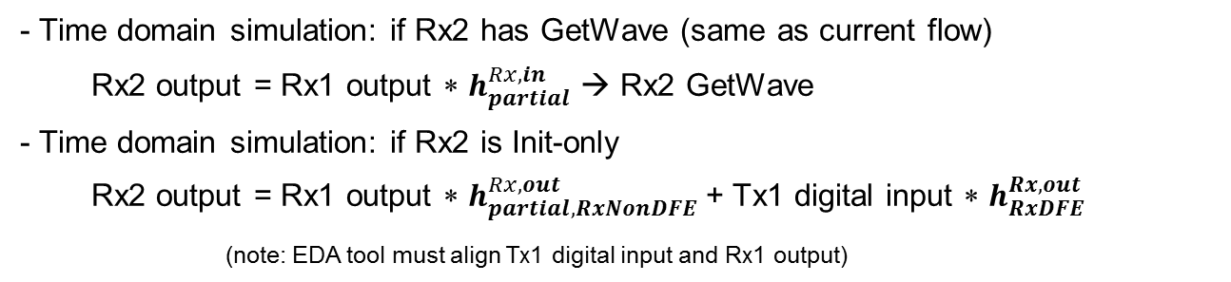

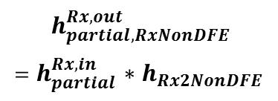
Redriver Time Domain Flow: Init-only Tx2
$$h_{partial,RxNonDFE}^{Rx,out}$$
= $h_{partial}^{Rx,in}$ ${∗h}_{Rx2NonDFE}$
$$h_{partial}^{Rx,in}=Tx2 Init output$$
Tx1
AC1
Rx1
Tx2
AC2
Rx2
Tx1
AC1
Rx1
Tx2
AC2
Rx2 Non-DFE
Rx Init input
impulses
Rx Init output
impulse
$$h_{RxDFE}^{Rx,out}$$
Rx2 DFE
$$h_{total}^{Rx,in}=$$
$$Rx1 Init output∗Tx2 Init output$$
$$h_{total,RxAll}^{Rx,out}$$
Rx2 Non-DFE
Tx1
AC1
Rx1
Tx2
AC2
Rx2
Tx1
AC1
Rx1
Tx2
AC2
Rx2 DFE
- Time domain simulation: if Rx2 has GetWave (same as current flow)
Rx2 output = Rx1 output ∗ $h_{partial}^{Rx,in}$ → Rx2 GetWave
- Time domain simulation: if Rx2 is Init-only
Rx2 output = Rx1 output ∗ $h_{partial,RxNonDFE}^{Rx,out}$+ Tx1 digital input ∗ $h_{RxDFE}^{Rx,out}$
(note: EDA tool must align Tx1 digital input and Rx1 output)

Slide 10
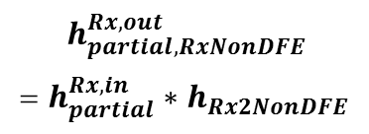
Redriver Statistical Flow
$$h_{partial,RxNonDFE}^{Rx,out}$$
= $h_{partial}^{Rx,in}∗{ h}_{Rx2NonDFE}$
$$h_{partial}^{Rx,in}=Tx2 Init output$$
Tx1
AC1
Rx1
Tx2
AC2
Rx2
Tx1
AC1
Rx1
Tx2
AC2
Rx2 Non-DFE
Rx Init input
impulses
Rx Init output
impulse
$$h_{RxDFE}^{Rx,out}$$
Rx2 DFE
$$h_{total}^{Rx,in}=$$
$$Rx1 Init output∗Tx2 Init output$$
$$h_{total,RxAll}^{Rx,out}$$
Rx2 Non-DFE
Tx1
AC1
Rx1
Tx2
AC2
Rx2
Tx1
AC1
Rx1
Tx2
AC2
Rx2 DFE
- Statistical uses $h_{total,RxAll}^{Rx,out}$ for victim and $h_{partial,RxNonDFE}^{Rx,out}$ for aggressors received by Rx1

Slide 11
Summary
No change to Tx Init
Augment Rx Init impulse matrix by two columns for total impulse and Rx DFE
Rx Init Input Impulse |  | Rx Init Output Impulse
Symbol | Definition | Symbol | Definition
$$h_{partial}^{Rx,in}$$ | Impulse from upstream Tx input or output, depending on whether Tx has GetWave and whether simulation is in time domain or statistical, to Rx input | $$h_{partial,RxNonDFE}^{Rx,out}$$ | Combined impulse of $h_{partial}^{Rx,in}$ and Rx’s non-DFE portion (including gain and linear EQ)
$$h_{total}^{Rx,in}$$ | Impulse from terminal Tx input to Rx input. Rx Init performs optimization based on this impulse | $$h_{total,RxAll}^{Rx,out}$$ | Combined impulse of $h_{total}^{Rx,in}$ and the entire Rx (including gain , linear EQ and DFE)
$$h_{RxDFE}^{Rx,in}$$ | Empty place holder for Rx Init to return DFE impulse | $$h_{RxDFE}^{Rx,out}$$ | Rx DFE. Aligned cursors to $h_{partial,RxNonDFE}^{Rx,out}$
$$h_{xtlk}^{Rx,in}$$ | Impulses from aggressors to Rx input | $$h_{xtlk}^{Rx,out}$$ | Combined impulse of $h_{xtlk}^{Rx,in}$ and Rx’s non-DFE portion (including gain and linear EQ)

Slide 12
New Reserved Parameters
Simulator_Supports_Augmented_Rx_Init_Impulse_Matrix
Boolean, In, Optional, Default=False
Set by simulator in the AMI_parameters_in input string of Rx AMI_Init to inform Rx model whether simulator supports the augmented impulse matrix
Rx_Init_Supports_Augmented_Impulse_Matrix
Boolean, Info, Optional, Default=False
Rx parameter that informs simulator whether Rx AMI_Init supports the augmented impulse matrix

Slide 13
New Reserved Parameters (cont’d)
Rx_Init_Supports_Augmented_Impulse_Matrix = False
Simulator doesn’t include Simulator_Supports_Augmented_Rx_Init_Impulse_Matrix in the AMI_parameters_in input string of Rx AMI_Init
Simulator sends unaugmented impulse matrix to Rx AMI_Init
Rx AMI_Init modifies the unaugmented impulse matrix
Simulator proceeds according to the existing flow
Rx_Init_Supports_Augmented_Impulse_Matrix = True &
Simulator supports the new flow
Simulator sets Simulator_Supports_Augmented_Rx_Init_Impule_Matrix to True in the AMI_parameters_in input string of Rx AMI_Init
Simulator sends augmented impulse matrix to Rx AMI_Init
Rx AMI_Init modifies the augmented impulse matrix
Simulator proceeds according to the new flow

Slide 14
New Reserved Parameters (cont’d)
Rx_Init_Supports_Augmented_Impulse_Matrix = True &
Simulator doesn’t support the new flow
Simulator doesn’t include Simulator_Supports_Augmented_Rx_Init_Impule_Matrix in the AMI_parameters_in input string of Rx AMI_Init
Simulator sends unaugmented impulse matrix to Rx AMI_Init
If Rx supports the existing flow, its AMI_Init modifies the unaugmented impulse matrix. Simulator proceeds according to the existing flow.
If Rx doesn’t support the existing flow, its AMI_Init errors out

